Slide 2
Report view
Create dashboards and reports ,by adding charts ,visuals and tables
What you see:-Canva where we can drag visuals , customize their appearance and add slicers to filter data
Use:-show your grade for an year in a bar chart or pie chart –this is where you create
(visualization pane - build visuals –add data to your visuals)

Slide 3
DATA VIEW/TABLE VIEW
This is where you look at your raw data –details of the table
What you see:-Rows and columns ,you can clean or edit the data here
Use case: Fix if we see a missing value

Slide 4
MODEL VIEW
What it is: where you see how all the tables in your data are connected
What you see:- How all the tables in our data are connected
Use Case: Helps you understand how different pieces of data (like grades, subjects, and teachers) are linked together.

Slide 5
PANES
Panes are like toolkits on the side of your screen that help you do specific things in each view.

Slide 6
Fields Pane
What It Is: A list of all the data fields (columns) in your tables.
Use: Drag these fields into visuals to create charts or graphs.
Example: Drag "Subject" into a pie chart to show the distribution of grades by subject.

Slide 7
Visualization pane
2. Visualizations Pane
What It Is: A toolbox with all the chart types you can use, like bar charts, line graphs, or maps.
Use: Pick how you want to display your data.
Example: Click on a bar chart icon to turn your data into a bar chart.

Slide 8
Filters Pane
3. Filters Pane
What It Is: A place to filter your data to show only what you need.
Use: Focus on specific data in your reports.
Example: Filter to show only grades from "2024" or only "Math scores."
Filter on this visual
Filter on this page
Filter on this report/on all pages

Slide 9
Format Pane
What It Is: A set of tools to change how your visuals look.
Use: Customize colors, fonts, and labels for your charts.
Example: Change the bar chart colors to blue and add data labels to show exact values.
Conditional Formatting:
Gradient, Rules, Field values-bar chart

Slide 10
Data Connectivity Modes

Slide 11
IMPORT MODE/offline mode
Power BI has three main modes to bring in data. Think of these modes as different ways to access and use data for your reports.
copy-pasting data from a book into your notebook. The data is brought into Power BI and saved inside it.
How It Works:
Power BI takes a snapshot of your data and stores it in the Power BI file.
You don’t need to stay connected to the original data source all the time.

Slide 12
advantage
DISADVANTAGE
Complex calculations possible
Can see data in table view
All features of powerBI can be used for the data
Make our work faster
Easy data accessing
Fast report performance
Any change in data can be seen in table view
High performance visuals
DAX
More space
Refresh is a need
Difficult to obtain real time data
Data size should be limited. Can’t load huge data

Slide 13
Refresh Methods
Manual Refresh:-Manually trigger a data refresh in power BI desktop. If no need of frequent updates we use this. Eg: Monthly sales of a company
Scheduled refresh:- Automate Data fresh at a specific time or intervals eg:Weekly report of a company
Incremental Refresh:-Only new and updated data is reloaded rather than the original full dataset
Eg: Company stores daily transaction

Slide 14
DIRECT QUERY MODE/ONLINE MODE
Data stays in orginal source
Every time you interact with a visual power BI send a query to the source to get the latest data
No refresh is needed
reading from the book directly
If your grades are stored online (like in Google Sheets or a database), Power BI will show the grades live whenever you open the report.

Slide 15
ADVANTAGE
disadvantage
Up to date
Real time data acess
Less storage use of powerBI
No refresh is needed all the time
Slower than import mode
Can’t use all features of powerBi
DAX query is not in use
Less performance
Internet connectivity is must
Can’t see in table view
Not possible to do calculations

Slide 16
LIVE CONNECTION
watching a live stream of a favorite movie
How It Works:
Power BI connects to an external model (like a pre-made report or data cube) in real-time.
You can’t edit or change the original data, just use it to create visuals.
Features:
Great for using pre-organized data sources.
You rely on the external system for updates.
our teacher sets up a live data report of class performance. You connect to it and create charts using the data but can’t change the teacher’s report.

Slide 17
When to Use Each Mode
Import Mode: When your data doesn’t change often and you want fast performance.
Direct Query Mode: When your data changes frequently, and you need live updates.
Live Connection: When you're working with a shared or pre-built data source.
In Simple Words:
Import Mode: Copy the data into Power BI (fast, works offline).
DirectQuery: Read data directly from the source (live but slower).
Live Connection: Stream data from an external shared model (great for teamwork).

Slide 18
COMPONENTS

Slide 19
Power BI Desktop
What It Is: The main app you install on your computer to create reports and visuals.
What You Do: Build your charts, graphs, and tables using data.
Example: Imagine you have a spreadsheet of your test scores. In Power BI Desktop,
you can turn that data into pie charts or bar graphs.

Slide 20
POWERBI SERVICE
. Power BI Service
What It Is: A cloud platform (online website) where you can share your reports and dashboards with others.
What You Do: Upload your reports to share with your teacher, friends, or teammates.
Example: After making your report about test scores in Desktop, you upload it online to show your teacher.

Slide 21
POWERBI MOBILE APPLICATION
Power BI Mobile Apps
What It Is: Apps for your phone or tablet to view reports and dashboards.
What You Do: Check your data reports anytime, anywhere.
Example: You can see your test score charts on your phone while on the bus.

Slide 22
POWER QUERY
ELT
DATA EXTRACTION
DATA TRANSFORMATION
LOAD

Slide 23
POWER PIVOT
DATA ORGANIZE
DATA MODELING
DATA ANALYSIS
What It Is: A tool to perform complex calculations and build data models.
What You Do: Create relationships between tables or perform advanced math on your data.
Example: If you have separate tables for "Subjects" and "Scores," Power Pivot connects them so you can analyze the scores by subject.

Slide 24
Power view
Visualization
Proper Designing
Presentation
Publish to powerBI service
Power View
What It Is: A tool to create interactive visuals and charts.
What You Do: Drag and drop data to create dynamic reports that you can explore.
Example: Build a bar chart that updates when you click on "Math" to focus on Math scores.

Slide 25
7. Power Map:What It Is: A tool to create 3D maps of data.
What You Do: Visualize data on a map (e.g., locations or regions).
Example: Show your classmates' locations on a map to see where everyone lives.
8. Power Q&A
What It Is: A question-and-answer feature to ask about your data in plain English.
What You Do: Type a question, and it creates a visual for you.
Example: You type, "What is the average Math score?" and it shows the answer as a chart.

Slide 26
Summary
Power BI Desktop: Create reports and visuals.
Power BI Service: Share your reports online.
Power BI Mobile Apps: Check reports on your phone.
Power Query: Clean and prepare data.
Power Pivot: Do calculations and connect tables.
Power View: Build interactive visuals.
Power Map: Show data on a map.
Power Q&A: Ask questions about your data.

Slide 27
DATA MODELLING

Slide 28
What is Data Modeling? Think of data modeling like building a blueprint for your data.
It’s a way to organize and connect your data so that Power BI can understand how things are related.
Once the relationships are set, you can create cool charts and reports without confusion.
Create a build a relationship between Fact Table and Dimension Table
DATA STRUCTURE
Star Schema
Snow Flakes Schema

Slide 29
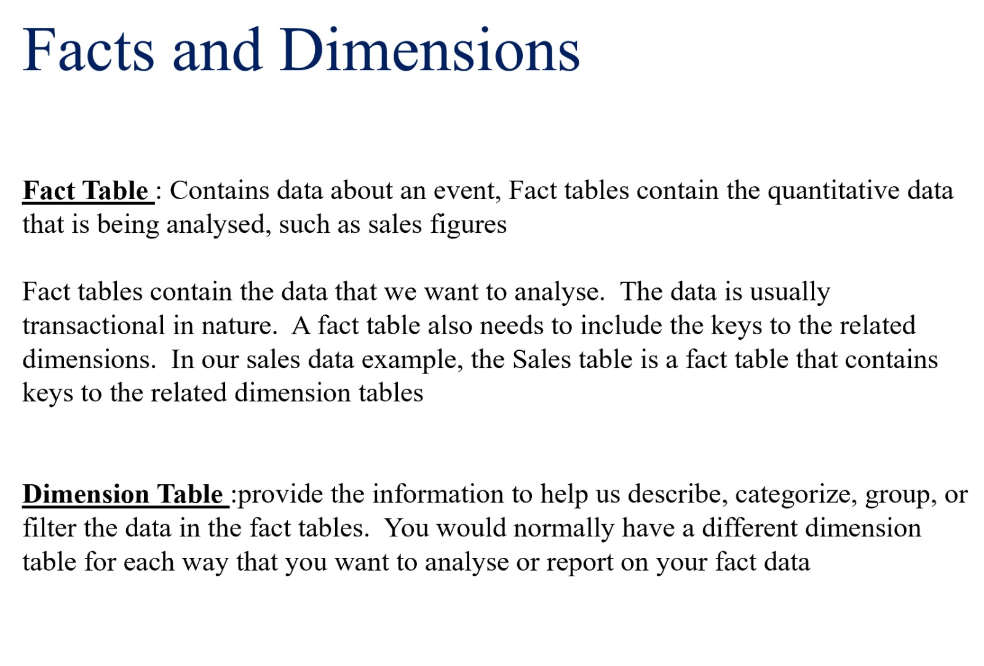

Slide 30
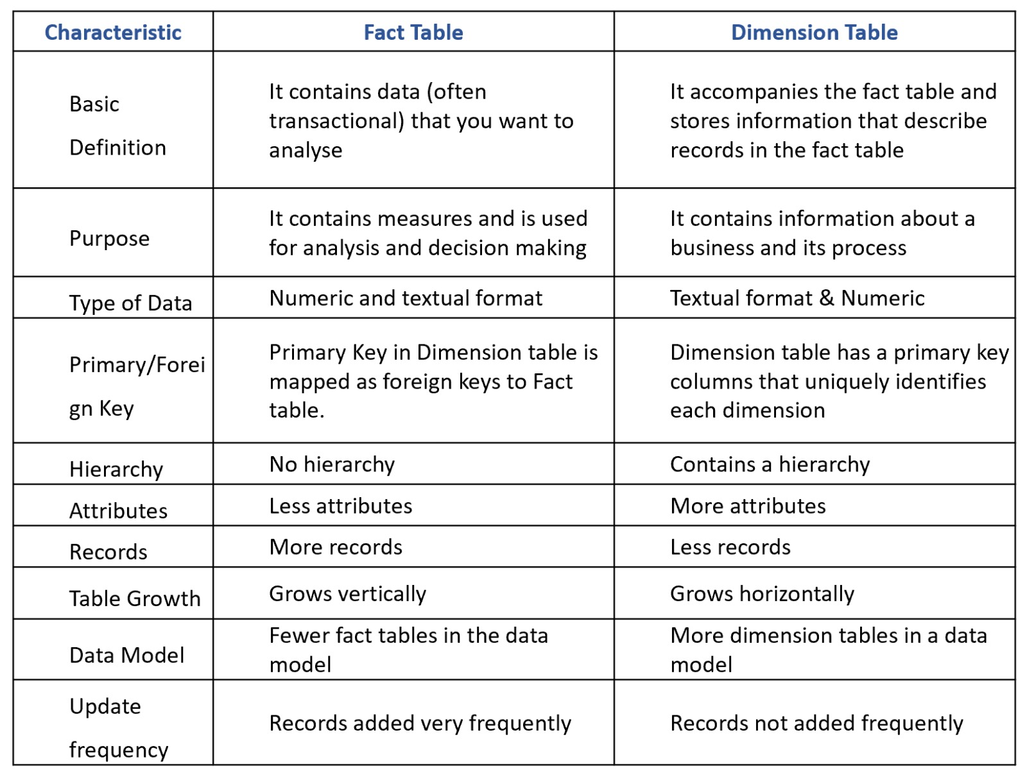

Slide 31
Foreign key
Primary Key of another value
Can have null values
Can have duplicates
Present in Fact table
To find relationship of tables
Primary key
Unique/Distinct Idetifier
No null
No duplicates
Find in Dimension table
Explain each row

Slide 32
How to find Table
Definition
Primary Key and Foreign Key
Purpose :-Fact table –Data Analysis .Dimension table-Process or flow of the business
Hierarchy:-FT-NO DT-YES
Records –Fact-more,DT-less
Atributes-DT-more,Fact- less
Update Frequency-Fact –more
Growth vertically-Fact,Horizontally-Dimension
Data Type: Fact-Numeric Dimension-Text
Data Model: Fact table –less,DT-more

Slide 33
Data Modeling
Why Do We Need Data Structures?
In data modeling, data structures are the ways we organize and represent data to make it easy to store, retrieve, and analyze. It’s like creating a blueprint for how data is arranged in a database or system.
Why Are Data Structures Important in Data Modeling?
Organize Data: Structures like tables and hierarchies make it easier to store and retrieve data.
Connect Information: Relationships and keys link different parts of the data, helping you see the bigger picture.
Ensure Accuracy: Data types and keys prevent mistakes, like storing a name in a "Grade" column.
Enable Analysis: Structures like hierarchies and schemas help analyze and visualize data effectively

Slide 34
Star Schema
What is it? The star schema is a simple structure where one central table (called a fact table) is surrounded by smaller tables (called dimension tables) that describe the data.
If you draw it, the design looks like a star—one big table in the center with lines connecting it to smaller tables around it.

Slide 35
Snowflake Schema
The snowflake schema is a more complex version of the star schema. In this design, the dimension tables are further broken down into sub-dimension tables, creating a more detailed and normalized structure.
Why It’s Called a Snowflake? If you draw it, the design looks like a snowflake—dimension tables are split into multiple levels.
Key Features of Snowflake Schema
Fact Table: Same as in the star schema, stores the main numbers.
Normalized Dimension Tables: Dimension tables are split into smaller tables to remove duplicate data.

Slide 36
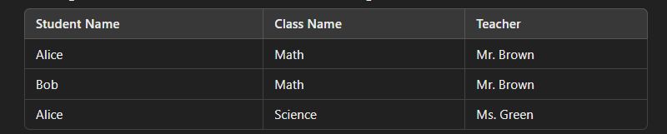
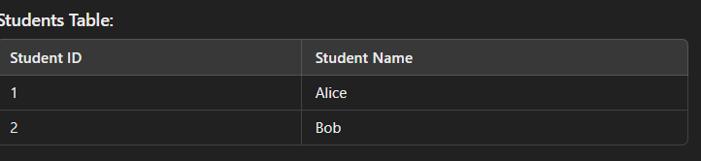
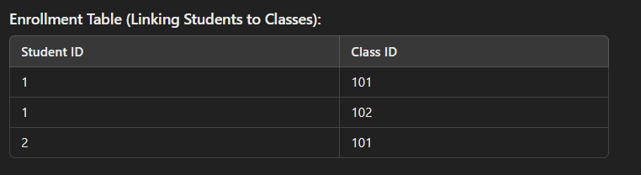
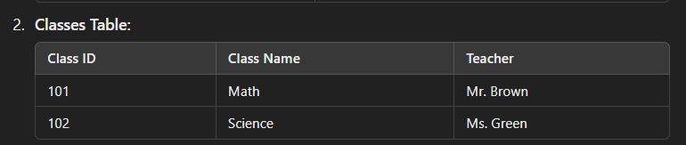
Normalization

Slide 37
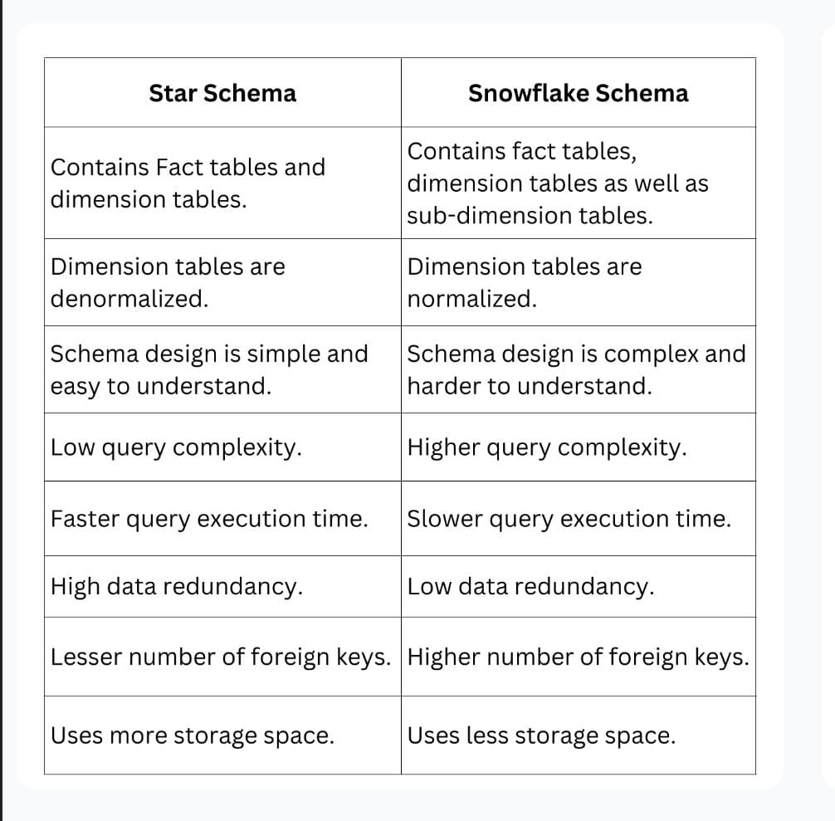

Slide 38
Charts
Column
PIE cahrt
Tall columns going on
Show comparison between two items
Vertical BARS
Who scored the highest
Detailed Comparison
Use Conditional Formating
Comparing Individual Things
ROUND
Showing part as a whole
What percentage of the total
Quick overall understanding
No conditional Formatting
Need Format Painter
How things are shared
Distribution of categorical values

Slide 39
Filters
Visual level Filters- specific cahrt
Page level filters-All charts in a page
Report Level Filter-Filter on all pages in report
view-show panes --- filters

Slide 40
Star
Snowflakes
Query Performance:more
Foreign key :less
Query Performance:less
More

